Slide 1
GROUP 8 / PYTHON COURSE PROJECT
Number Utility
Toolkit
A menu of small tools for exploring numbers
Rajesh Chaurasiya · Manas Dubey · Sweta · Pavan Kumar
Python Programming

Slide 2
What the program is for
02
The toolkit gives a user one place to run common number checks and calculations.
12
Enter an option from the menu and provide whole-number input.
See the result immediately, then find it later in the saved results file.
menu choices
Invalid input is handled with a message so the menu can continue.
one .py file

Slide 3
Number tools included
03
Prime, palindrome, Armstrong and perfect checks
GCD and LCM for two numbers
Digit sum, digit count and number reversal
Prime list up to a chosen limit
Factorial and Fibonacci sequence
Multiplication tables and recent results
Limits keep recursive calculations and printed tables manageable.

Slide 4
How a menu choice becomes a result
04
1 Choose
menu option
2 Check input
and range
3 Run a
number function
4 Display
and save
The menu repeats until the user selects Exit.

Slide 5
Course topics used in the code
05
Dictionary
Keeps calculation results during the current run
Set and tuple
Stores found primes without duplicates; functions return fixed tuples
Lists
Collects saved lines; append, remove, slice and sort are used
Strings and operators
Cleans operation labels and validates menu input
Loops and conditions
Drive the menu, checks, prime search and tables
Files, exceptions, doctests
Loads and saves a text log; bad inputs are handled; examples check functions

Slide 6
Recursion and nested loops
06
Recursion
Nested loops
Factorial
Prime search
n × factorial(n − 1)
Stops at 0 or 1
Outer loop checks each number.
Inner loop tests possible divisors.
Fibonacci
Multiplication tables
fib(n − 1) + fib(n − 2)
Stops at 0 or 1
Outer loop selects a number.
Inner loop multiplies it by each value.
GCD
gcd(b, a % b)
Stops when b is 0

Slide 7
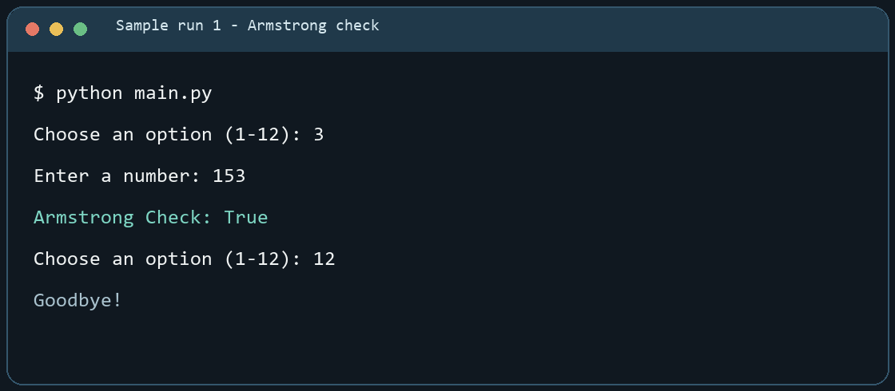
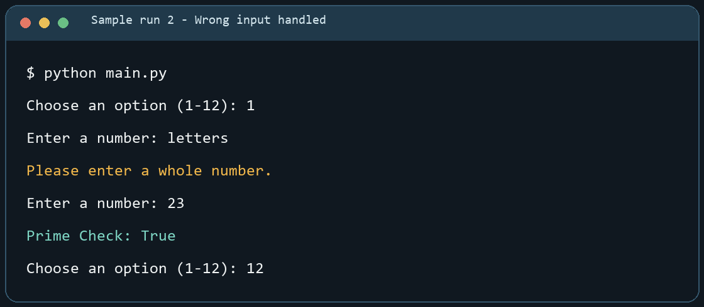
Sample runs from the program
07
Successful calculation
Invalid input is handled
Both examples come from running main.py. The second run rejects letters, then accepts a number.

Slide 8
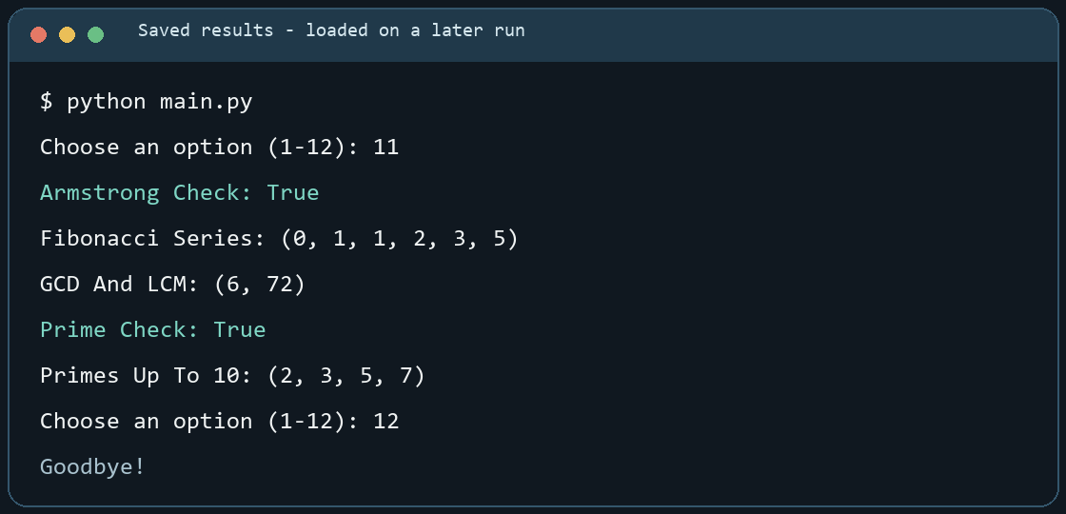
Results stay in the text file
08
The program appends each calculation to number_utility_results.txt. On the next run, option 11 reads the saved lines and shows up to five recent results.
What is stored
Calculation label
Result value
One line per result
The file can be opened in a text editor.

Slide 9
Running the project and next steps
09
To run the demo
Current limits
Open the Number_Utility_Toolkit folder
Whole numbers only
Run python main.py (or py main.py)
Factorial and Fibonacci stop at 20
Try options 3, 9, 10 and 11
Prime listing stops at 500
Run python -m doctest -v main.py
No option to clear or export the log
Next improvements could add decimal support for selected tools and a clear-history option.

